Slide 1


Introduction to Python Programming
Part 3: Adding Comments to your Code

Slide 2
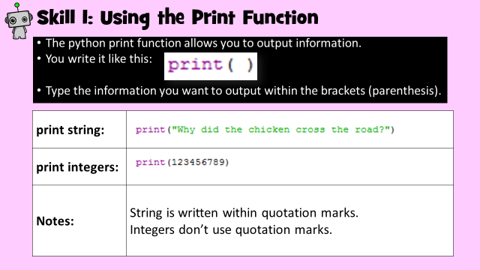
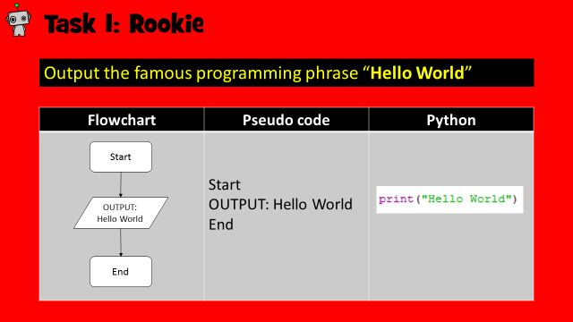
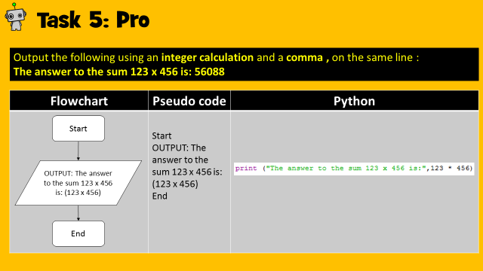
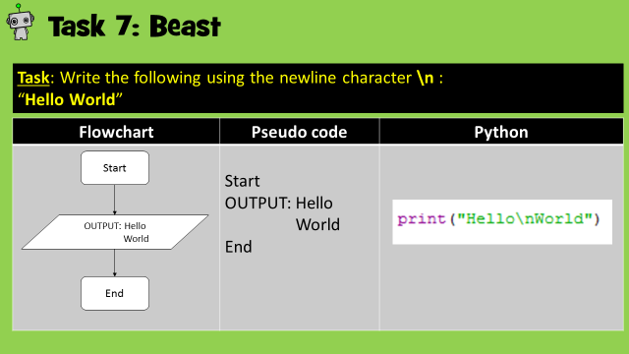
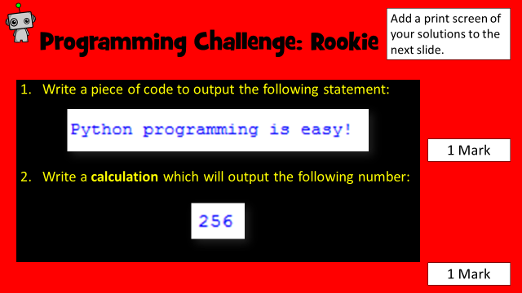
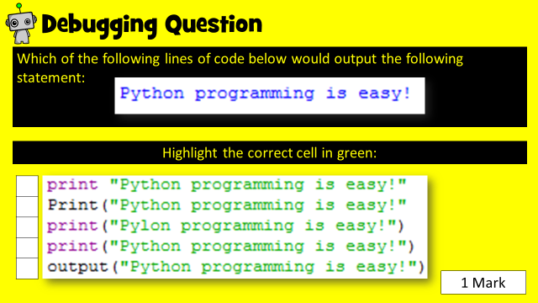
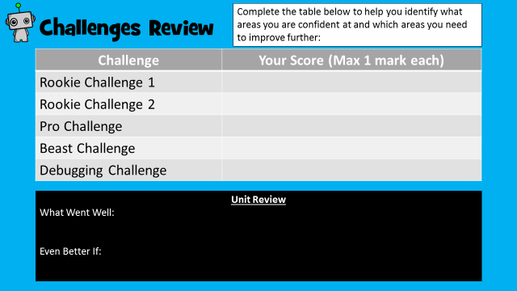
How to use this resource
Within each unit, you will learn how to develop and apply a range of Python programming skills. Skill explanations are in pink.
After reading the explanation of a skill, apply it within the given tasks. The tasks are categorised into Rookie (Easy), Pro (Medium) or Beast (Hard).
Once you have learned how to apply your new skills, demonstrate your ability by completing the given challenges. Don’t forget the debugging task!
Once complete, review your performance!
Skill Explanations: Pink Slides
Tasks: Rookie Pro Beast
Challenges: Rookie Pro Beast

Slide 3
Learning Objectives
Rookie
To understand why adding comments to your code is useful.
To be able to add comments within your python code.
Pro
To write comments which help to explain what programming techniques you have used.
Beast
To write clear and precise comments which means that someone else can understand your programming techniques.

Slide 4
Skill Contents
Once you complete a skill, colour code the box to show your level of confidence. You can always revisit the skill later on to boost your confidence.
Contents | Confidence Level
Adding comments in Python #
Comment out code
Key | Colour Code
I am very good at this skill and could show a friend how to do it.
I am confident I can perform this skill on my own.
I need to improve my understanding of this skill.

Slide 5
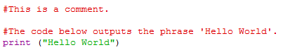
Why do we add comments?
Programmers add comments within their code for the following reasons:
It helps explain the programming techniques written and how they work.
If a programmer wants to reuse their code in the future, using comments will help identify the required piece of code.
They provide explanations for other people who may wish to use the code, or learn the same programming technique.

Slide 6
Skill 1: Adding comments in python
To add a comment, simply type in a hashtag symbol # followed by the required information.
You write it like this:
As a rule, always add comments to explain the code below the comment.

Slide 7
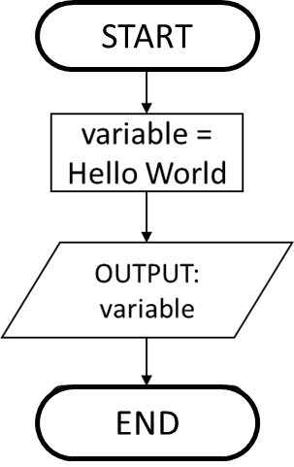
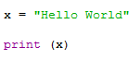
Task 1: Rookie
Store the phrase Hello World within a suitable variable.
Print the variable.
Add comments to your code to explain what you have done.
Flowchart | Pseudo code | Python
 | START variable = Hello world OUTPUT: variable EEND | Add comments to the code below:

Slide 8
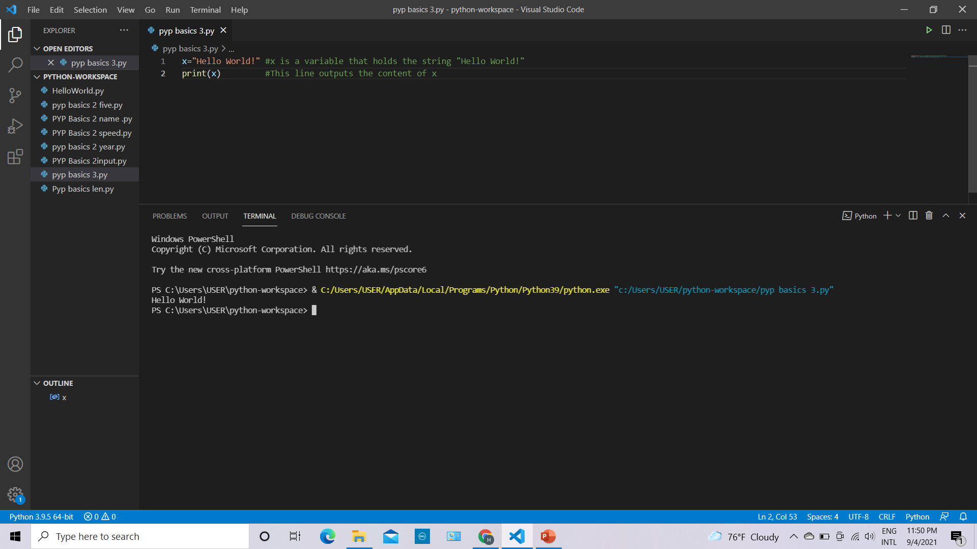
Task 1: Solution
Add a print screen to show your coding here.
Add a print screen to show your output solution here.

Slide 9
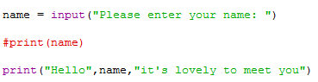
Skill 2: Comment out code
Another useful technique you could use comment for is to temporarily remove a line of code.
For example, if you only want to use a print command to check if a variable is storing the correct information, you may want to comment it out:
As you can see, this piece of code is only used to check that data is being stored in the name variable. It can be uncommented at a later date.

Slide 10
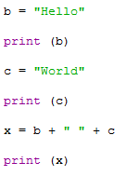
Task 2: Pro
Write out the code below:
Comment out the code lines that print out variables b and c so only x is outputted.
Python

Slide 11
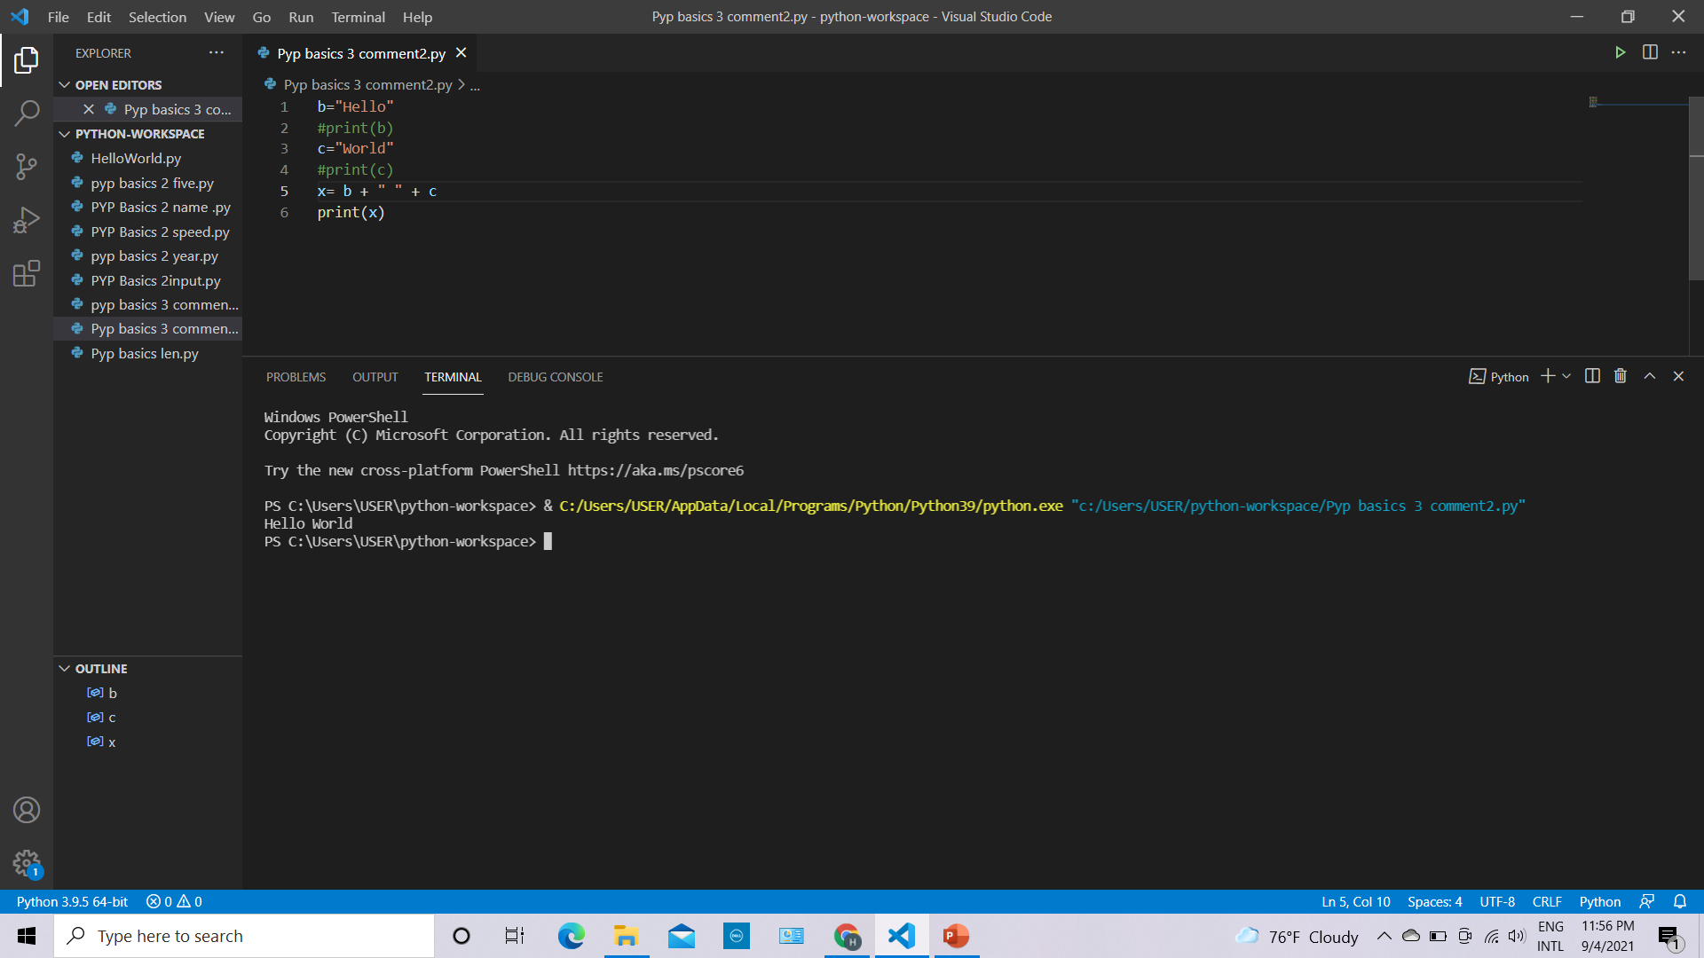
Skill Task 2: Solution
Add a print screen to show your coding here.
Add a print screen to show your output solution here.

Slide 12
Programming Challenges
Now you have learned some programming skills, it’s time to put them into practice!
Complete the following programming challenges. Start with the Rookie challenge and see how far you can push yourself.
Finally, complete the debugging challenge.
Once you have finished your challenges, complete the review. Look back at the skills you have learned so far to help you solve the challenge.

Slide 13
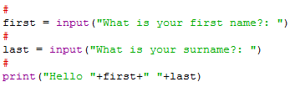
Programming Challenge: Rookie
Add a print screen of your solutions to the next slide.
Write out the code below and add a suitable comment to explain what is happening for each line of code:
1 Mark

Slide 14
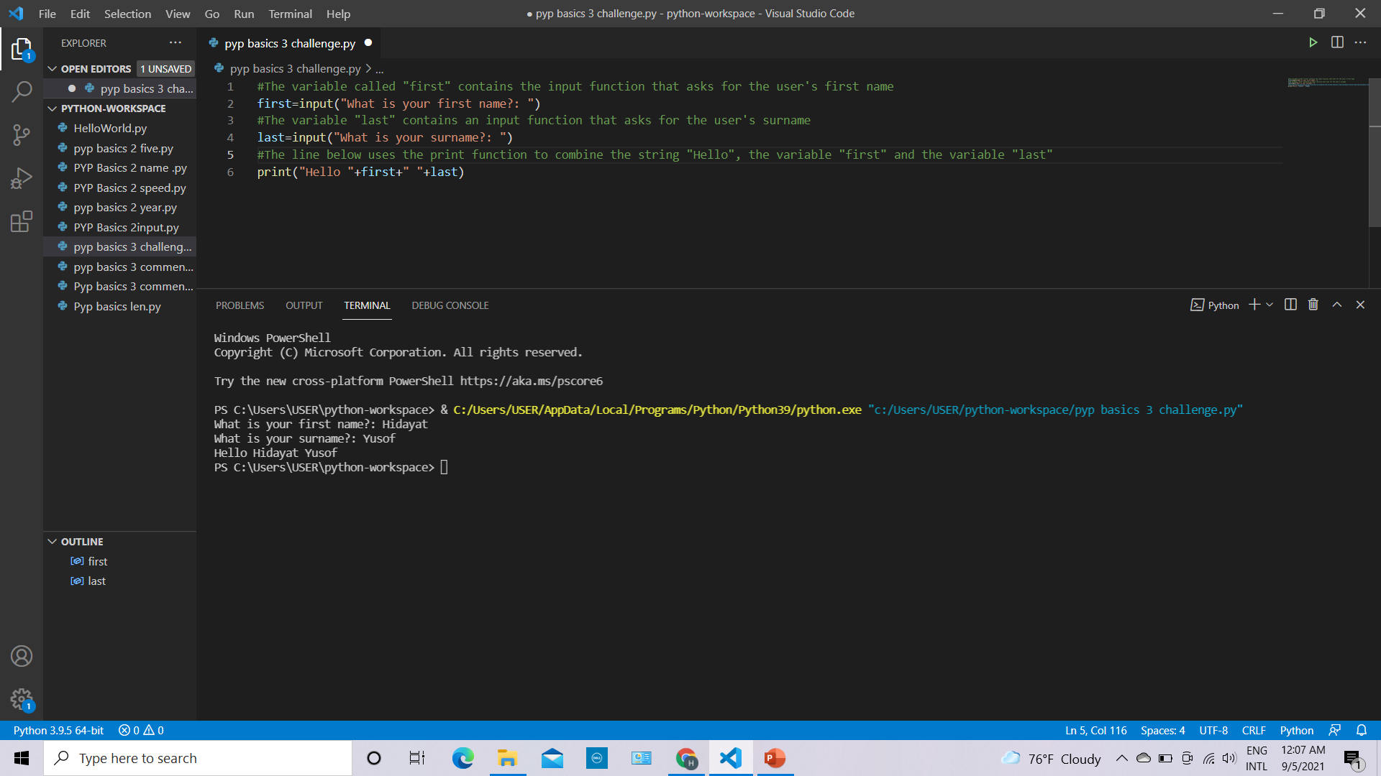
Programming Challenge: Rookie - Answer
Add a print screen to show your coding here.
Add a print screen to show your output solution here.

Slide 15
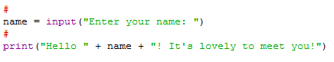
Programming Challenge: Pro
Add a print screen of your solutions to the next slide.
Write out the code below and add a suitable comment to explain what is happening for each line of code:
1 Mark

Slide 16
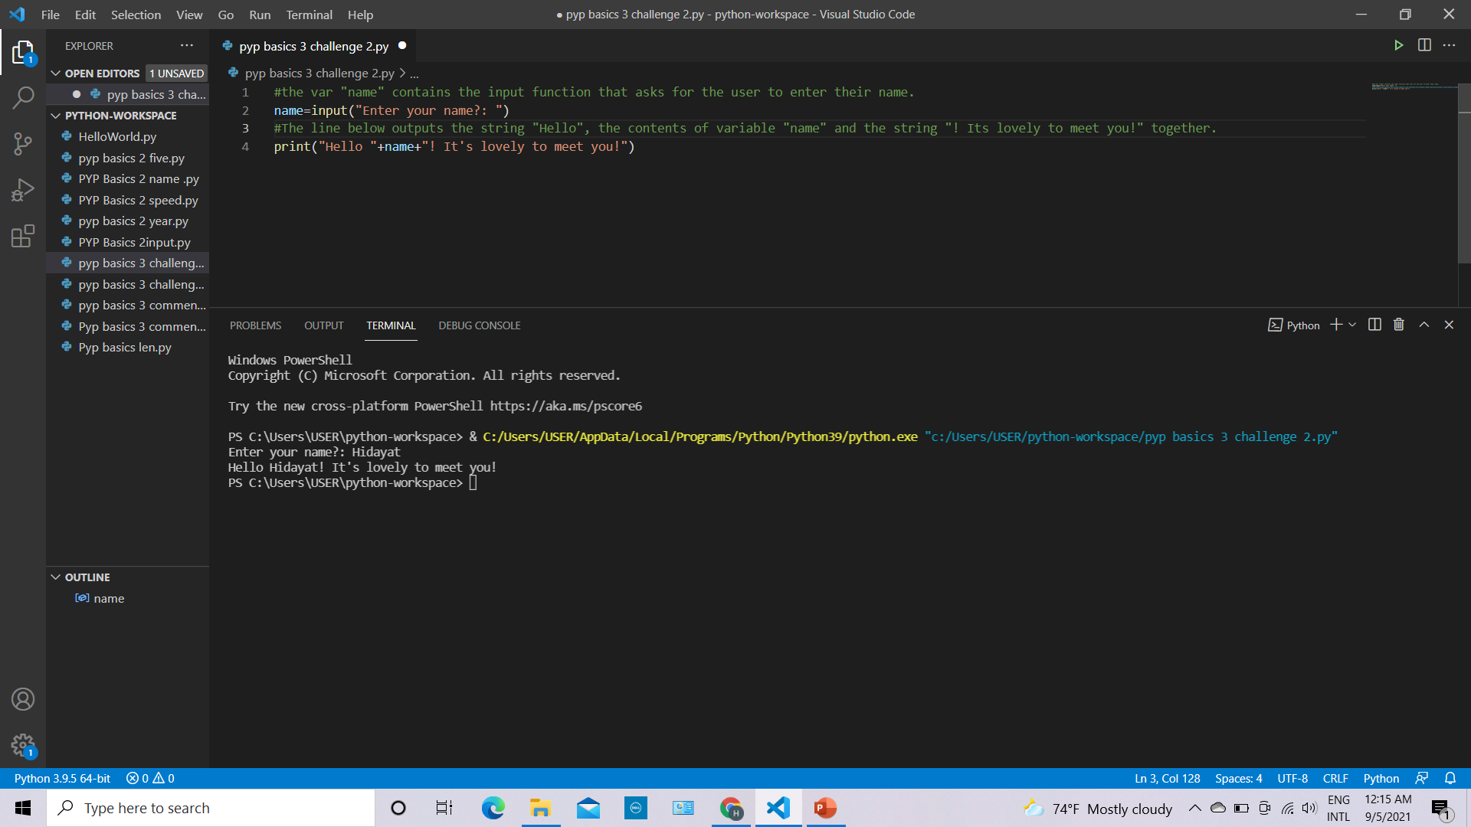
Programming Challenge: Pro - Answer
Add a print screen to show your coding here.
Add a print screen to show your output solution here.

Slide 17
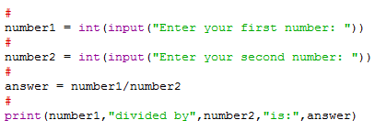
Programming Challenge: Beast
Add a print screen of your solutions to the next slide.
Write out the code below and add a suitable comment to explain what is happening for each line of code:
1 Mark

Slide 18
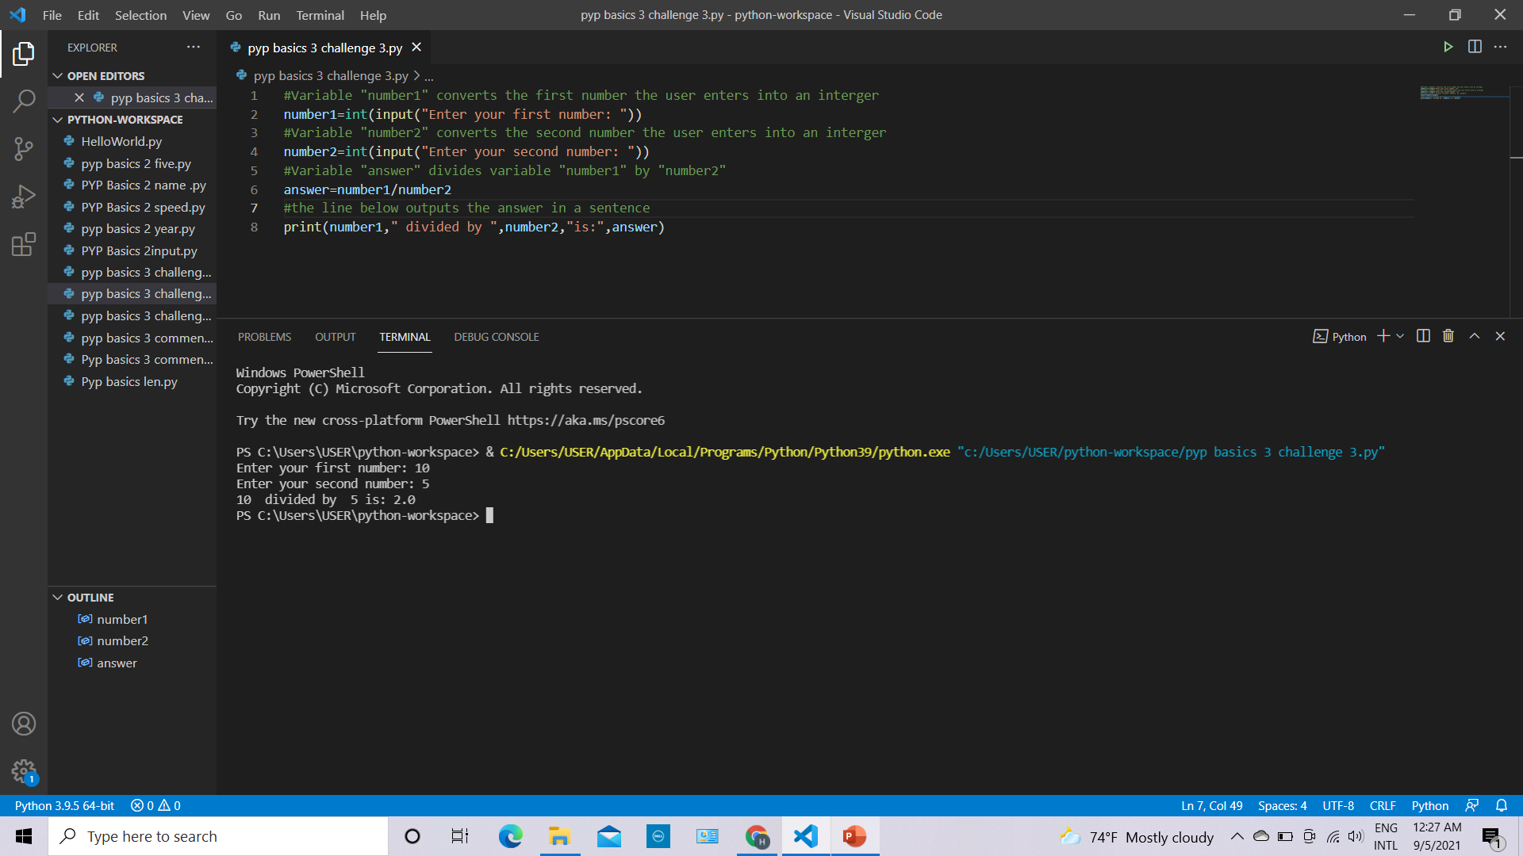
Programming Challenge: Beast - Answer
Add a print screen to show your coding here.
Add a print screen to show your output solution here.

Slide 19
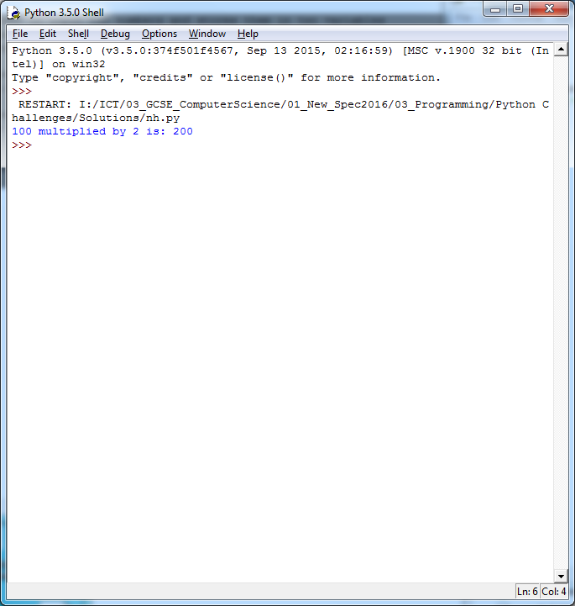
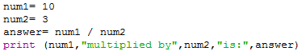


Debugging Question
Which of the following lines of code below would output the following statement:
Highlight the correct cell in green:
1 Mark

Slide 20
Challenges Review
Complete the table below to help you identify what areas you are confident at and which areas you need to improve further:
Challenge | Your Score (Max 1 mark each)
Rookie Challenge | 1
Pro Challenge | 1
Beast Challenge | 1
Debugging Challenge | 1
Unit Review
What Went Well: Nothing wrong in this one
Even Better If: no comment

